Slide 1
Javascript
Presented by
Dean Corbin THE HOUSE of the Good Shepherd
Yueh Peng Maryville Academy

Slide 2
Reference Material
This reference material are for your reference only, I check most of them in 10.1.0250.
You will know lots of basic and advance knowledge if you can understand and follow through the material.

Slide 3
Material Outline
Resource
JavaScript functions and variables
Basic
Classic to NX
Case Study – How to find JavaScript codes in your system ?
Case Study – How to protect Form Data ?
Case Study – How to manipulate SubReport ?
Case Study – How to manipulate SubForm ?
Case Study – How to create a dynamic form ?
Case Study – How to copy info from other place ?
Case Study – How to make link between events?

Slide 4
Resource
Dean Corbin Blog: https://blog.corbinet.com/category/myevolv/
Netsmart Community : https://netsmartcares.force.com/s/group/0F970000000XezJCAS/myevolv-national-user-group
Mentors Recording : https://www.gotostage.com/channel/myevolv-office-hours (Need to be a member)
W3 School : https://www.w3schools.com/js/
Training Site : https://www.pluralsight.com (Need to be a member)
Book Club : https://www.safaribooksonline.com/ (Need to be a member)
Developer Community : https://stackoverflow.com
Free Video Training : https://www.youtube.com/

Slide 5
Tools
Editor : https://notepad-plus-plus.org/downloads/
HTML online Editor : https://html-online.com/editor/
Online Editor Tools(Jason/HTML/XML/SQL) : https://www.freeformatter.com/json-formatter.html
Online Text comparison tools : https://www.diffchecker.com/
Best Place to learn : https://www.google.com

Slide 6
JavaScript function and variable
There are more than 1700+ JavaScript functions and Variables already created by NetSmart

Slide 7
Dom Object Reference
Form.formObject | Form.formObject.formMode | Form.formObject.parentValue | Form.formObject.keyValue
 | Form.formObject.formHeaderId | Form.formObject.dataTable | Form.formObject.parentTable
 | Form.formObject.parentColumn | Form.formObject.sitePS | Form.formObject.programPS
 | Form.formObject.serviceTrack | Form.formObject.eventID | Form.formObject.isLocked
 | Form.formObject.isDraft | Form.formObject.isApproved
 | Form.formObject.BeforeLoad | Form.formObject.afterLoad | Form.formObject.onSave
 | Form.formObject.beforeSave | Form.formObject.onDelete | Form.formObject.isAddAllowed
 | Form.formObject.isEditAllowed | Form.formObject.isAmendAllowed | Form.formObject.isDeleteAllowed
 | Form.formObject.signAllowed | Form.formObject.unsignAllowed | Form.formObject.isESigned
formLine | formLine.columnName | formLine.caption | formLine.typeCode
 | formLine.formLinesId | formLine.isModifiable | formLine.isVisible
 | formLine. isRequired | formLine.isVisible | formLine..isDirty
 | formLine. onloadEvent | formLine. onchangeEvent | formLine. onclickEvent
 | formLine.disableRule | formLine.isEraseOnDisable | formLine.isDisabled
 | formLine.defaultValue | formLine.value | formLine.oldValue

Slide 8
Functions
Category | Function Name | Example | Comment
Message | alert('Message') | alert('This is a alert')
 | confirm('Message') | confirm('Are you sure ?')
DateTime | calculateDate(xdays) | calculateDate(10) | Add xdays from today
 | getTimeDifferenceInMinutes(from_time, to_time) | getTimeDifferenceInMinutes(getFormElement('actual_date'), getFormElement('end_date')) | This function only work for people activity form family
 | propagateDuration2ParentEvent() |  | propagate the duration on other activities sub-form onto the parent event duration
 | convertDurationToMinutes = FormUtil.convertDurationToNumeric(value) | convertDurationToMinutes(getFormElement('duration')) | convert duration string to number of minutes assumes format "00:00" or "0000"
 | todaysDate() | 10/25/2019 | If formObject is not provided,
 | todaysDateTime() | 10/25/2019 12:19 PM
Form DOM Object | Form.getFormLineById(formLineId, formObject) |  | If formObject is not provided,
 | Form.getFormLineByColumnName(columnName, formObject) | getFormLineByColumnName('actual_date') | formObject = Form.formObject
 | Form.getFormLineByCaption(caption) | getFormLineByCaption('Staff Name')
 | Form.getFormElement(name, formObject) | getFormElement('actual_date') | Get the value stored in a form line
 | Form.setFormElement(name, formVal, display, prompt, execDisableRules) | setFormElement('actual_date', str) | Set a form line value
 | Form.getDescription(lut_code, fkey_value, andPrompt) | getDescription(Form.getFormLineByColumnName('MY_Baby_D1').lutValue.scrnval_id, getFormElement('MY_Baby_D1'))
 | Form.getParentFormElement(sField) |  | popupform which has been launched from a subform gets value from a field element located in a calling form
 | Form.getSubReports |  | get all the subreport object
 | Form.getSubForms |  | Get all the subreport object
Notes:
Lots of place we should use Form.FunctionName else you will get function is not defined

Slide 9
Functions
Category | Function Name | Example | Comment
Form Attribute | Form.setDisableRules (columnName) | Form.setDisableRules(formLine.columnName); | Apply the disable rule to a field
 | Form.setDisabled(columnName, disableRule, formLinesID) | setDisabled(formLine.columnName, 'true') | Trigger the disable according to the condition
 | Form.makeRequired($obj) | makeRequired(Form.getFormLineByColumnName('staff_id'))
 | Form.makeUnRequired($obj) | makeUnRequired(Form.getFormLineByColumnName('staff_id'))
 | Form.subformRequiredToggle(caption, suppress, hide) | subformRequiredToggle("Exception", true, false) | Toggle Subform Required, Caption is the Subfomr Caption
 |  | subformRequiredToggle("Exception", false, false) | Subform need at least one record
 | Form.SetScrnval(fieldName, sLUTCode, sDepends, sDependsOther) | SetScrnval("program_responsible", "program_info", "agency_id", "getFormElement('staff_responsible')") | Change the lookup table - before open the lookup
Get Data from database | getDataValue(tableFrom, codeField, codeValue, returnField, conditionExpr, orderExpr) | getDataValue('primary_worker_assignments_view','people_id',parentValue, 'staff_id', 'end_date IS NULL and program_info_id = \'\''+programPS+'\'\'') | can take those condition in newer release"IS NOT NULL","IS NULL","NOT LIKE","LIKE",">=", ">" ,"<=" ,"<", "="
 | getDataValueWithFunction(tableFrom, codeField, codeValue, returnField, returnFieldAlias, conditionExpr) | getDataValueWithFunction('primary_worker_assignments_view','people_id',parentValue, 'staff_id', null, 'end_date IS NULL and program_info_id = \'\''+programPS+'\'\'') | Just like getDataValue(tableFrom, codeField, codeValue, returnField, conditionExpr, null)
misc | isChecked(elementName) | isChecked("is_noshow")
 | isNullOrEmpty(str) | isNullOrEmpty(Form.getFormElement('staff_id')) | Return true if a string is null or empty (or undefined)
 | isNullOrWhiteSpace(str) | isNullOrWhiteSpace(getFormElement('gender_id')) | Return true if a string is null or has whitespace
 | padLeft (s, n, c) |  | left padding s with c to a total of n chars
 | padLeft (s, n, c) |  | right padding s with c to a total of n chars
 | trim(str) |  | trim the string
 | FilterString(inputString, cTemplate) | FilterString(getFormElement( 'total_amount'), '01234567890.') | Filter the string to leave only characters passed in template
Notes:
'staff_id‘ is the info save in the form
‘workerID’ is logon user
GetDefaultStaff() will return ‘’ if the formmode != "ADD" && Form.formObject.formMode != "REVIEW“ else it will return workerID

Slide 10
Variables
Notes:
agencyID, belongs2Event, currentAgency, eventCategory, eventID, events2DoRemarks ,eventSiteID, keyValue,programEnrollment, schedLoc, serviceTrack, sitePS, workerID
Select distinct FV.column_name, FV.default_value
From Form_View FV
left join form_lines_denorm fld on FV.form_name = fld.form_name and FV.column_name = fld.column_name
where FV.default_value in
('agencyID', 'belongs2Event', 'currentAgency', 'eventCategory', 'eventID', 'events2DoRemarks' ,'eventSiteID', 'keyValue',
'program_info_id' ,'programEnrollment', 'schedLoc', 'serviceTrack', 'sitePS', 'userSite', 'workerID')

Slide 11
JavaScript Basic
The timing(when/where) you put the code is very important
Form Header
Before Save Code
After Save Code
After Delete
Before Load code
After Load Code
Form Field
On Load Script
On Click Script
On Change Script
Default Value
Disable Rule
Code Trigger Sequence
On load -> Disable Rule -> Default Value -> disable -> On Change-> Before Load -> After Load
Disable Rule -> onfocus -> On Change -> On Click -> onblur
On load -> Disable Rule -> Default Value -> On Change-> disable -> Before Load -> After Load (after 325)
Notes:
The Limitation is 9999 characters for 'On Change Script', 'On Click Script’
The Limitation is 8000 characters for 'Default Value’ , 'Disable Rule’ and all the code in form header.
The Limitation is 517 characters for 'On Load Script',
‘on change script’ will not trigger if you choose the same info before you save , you have to modify the old value to make the system reflect the change
// for a FK
formLine.lutOldValue.value = getFormElement('MY_Child1');
// Other
formLine.oldValue = getFormElement(‘actual_date');

Slide 12
Classic to NX
If you didn't using JavaScript in your system
If you only using the function/variable created by NetSmart – such as
getFormElement, getElementFromXML,
setFormElement, setElementFromXML
getDataValue, makeUnRequired, makeRequired
agencyID, eventID, keyValue , parentValue, programPS, sitePS, workerID
If you are using pure JavaScript function after you get the reference of the DOM object.
There is no different for the JavaScript part since JavaScript is JavaScript.
The difference is how NetSmart designed the system – especially for the DOM (Document Object Model) object.
The other difference are how function/variable are being defined/used in the system.
The way to handle SubForm is different.
The last one – how the web page get designed – It will affect how you write the code if you try to manipulate the form via jQuery.

Slide 13
Classic
NX
getDataValue are lower case in Classic
getElementFromXML and getFormElement are upper case and could be different value in Classic
setElementFromXML and setFormElement are different in Classic, setFormElement will update the screen, setElementFromXML update in the back so you cannot see the change but it will still save the data
All the variable are upper case in Classic
Classic will not run 'Before Load Code' and 'After Load Code' if the event get lock
the fk key return upper case in Classic and surrounding by {}
Before Load, After Load, Before Save code need to use {{ and }}.
getDataValue are upper case in NX
getElementFromXML and getFormElement are lower case and are the same in NX
setElementFromXML and setFormElement are the same in NX
All the variable are lower case in NX
NX will run 'Before Load Code' and 'After Load Code' even the event get lock
the fk key return lowercase in NX
Notes:
Classic to NX
need to replace &lt; to < and &gt; to >.
need to replace &quot; to "
need to replace &amp;&amp; to &&
disable rule still allow use &amp;&amp; &lt; &gt; in NX
need to change getDataValue function if you have complex comparison
need to change 'true' to 'True', 'false' to 'False' in bit comparison
You can replace the escape character ' with " -- old one is 'people_id =\'\''+ pid+'\'\'' change to "people_id ='"+ pid+"'" , you don't need to change and the program will still work.

Slide 14
Case Study – How to find JavaScript codes in your system ?
You want to find codes sample or where all the code located in where
Select distinct form_family_name, form_name,user_defined, form_lines_user_defined, caption, group_order, line_order, table_name, column_name, type_code, on_save , before_save, on_delete, before_load, after_load, onload_event, onclick_event, onchange_event, default_value, disable_rule
From Form_View
where
( ( on_save is not null and on_save <> '' ) or
(before_save is not null and before_save <> '' ) or
(on_delete is not null and on_delete <> '' ) or
(onchange_event is not null and onchange_event <> '' ) or
(onclick_event is not null and onclick_event <> '' ) or
(default_value is not null and default_value <> '' ) or
(disable_rule is not null and disable_rule <> '' ) or
(onload_event is not null and onload_event <> '' ) or
(after_load is not null and after_load <> '' ) or
(before_load is not null and before_load <> '' )
) and user_defined= 1

Slide 15
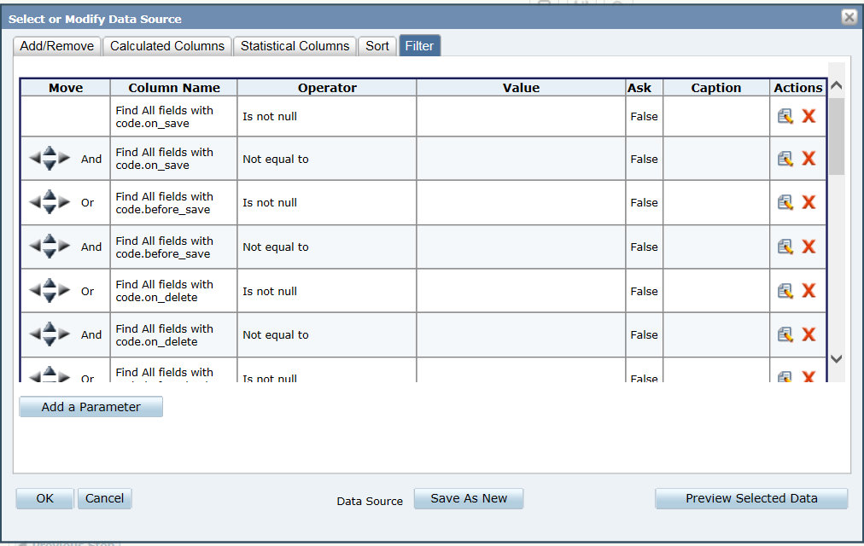
How to find JavaScript codes in your system – Using Data Insight
Create a new virtual view (All Forms with JS) – Add the Where clause if you want to narrow down by Form Family Name.
SELECT * FROM form_view
WHERE form_family_name in ('Activities - People','Tests and Assessments (People)','Other Activities')
Create a new report and select your new Virtual View, add the following fields
form_family_name, form_name, user_defined, form_lines_user_defined, caption,group_order, line_order, table_name, column_name, type_code, on_save, before_save, on_delete, before_load, after_load, onload_event, onclick_event, onchange_event, default_value, disable_rule

Slide 16
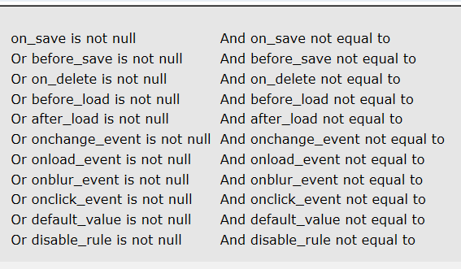
On each “And” filters select “Next to the previous parameter” this keeps the top of your report from getting really long.
Here is what the top of your report will look like once you’ve added your filters

Slide 17
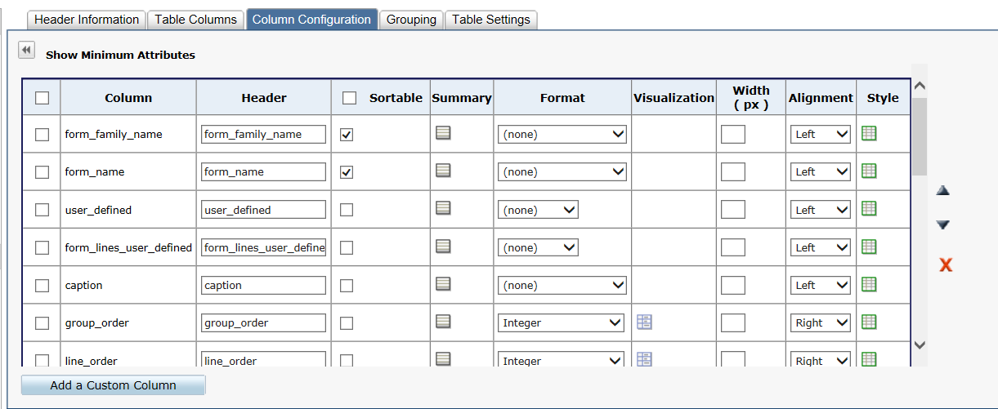
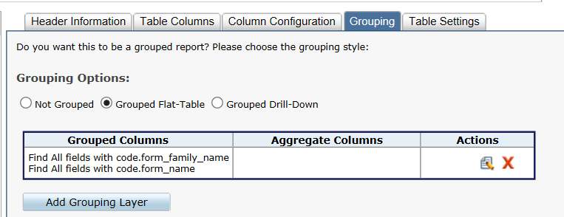
Column Configuration – I wanted to sort by Form_family_name and Form_family
Grouping – I choose Grouped Flat-Table and added form_family_name and form_name as a grouping layer

Slide 18
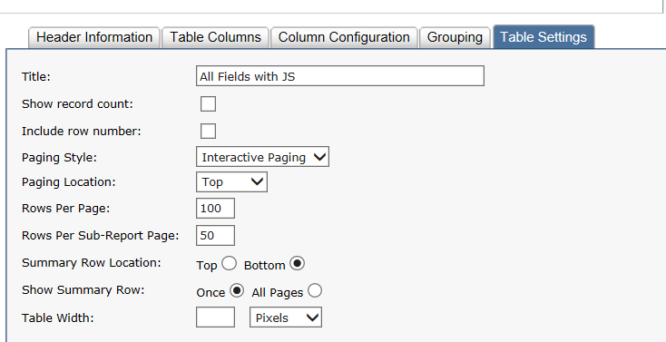
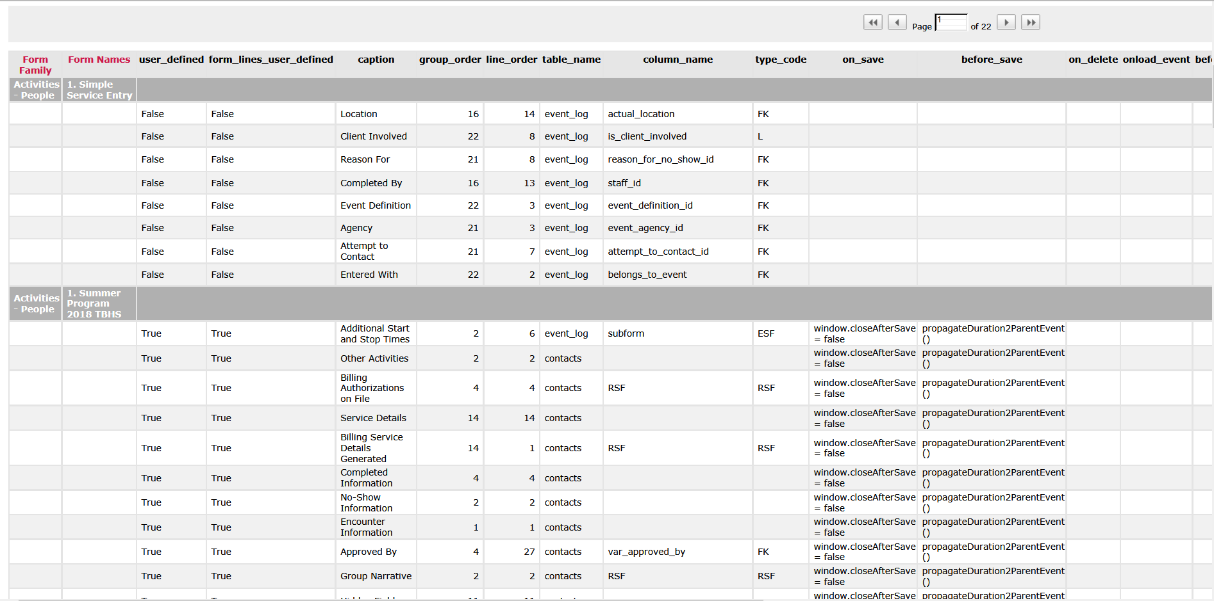
Table Settings – I decided to show 100 rows per page
And we have our report!

Slide 19
Here is the Virtual View I used to pull my report.
SELECT * FROM form_view
WHERE form_family_name in ('Activities - People','Tests and Assessments (People)','Other Activities','Benefit Assignment','Consents','Group Activities',
'Group Activities - Other','MSDP Tests and Assessments','MST Events','NYSCRI Progress Notes','NYSCRI Test and Assessments','Materials','Referrals to Agency',
'Requirements for People','Restrictions/Alerts','Substance Use','Treatment/Service Plans for People')
Form Families Commonly Used
Activities | MSDP Tests and Assessments
Activities - Other | MST Events
Adoption Activities | Notice of Decision
Benefit Assignment | NYSCRI Progress Notes
Consents | NYSCRI Test and Assessments
Diagnosis | Placement and Treatment History
Discharges | Placement Disruptions
Evidence Based Practice | Post Discharge Follow Ups
Family Case Activities | Problems/Needs
Family Case Activities - Other | Program Eligibilities
Family Case Test/Assessment | Program Enrollment
Group Activities | Program Modifier
Group Activities - Other | Referrals Made (to Programs or Out)
HCBS Test/Assessments | Referrals Made Status
HCBS-Activities | Referrals to Agency
Health | Requirements for People
Home Health Care Activities | Requirements for Profiles
Immunizations | Restrictions/Alerts
Incident Medical Exam | Service Plan Addendum
Incident Medications | Service Plan Development
Incident Physical Findings | Service Track - Agency Placement
Incident Restraints | Status History
Incidents Header | Strengths
Income Information | Substance Use
Inquiries for People | Test/Assessments for People
Inquiries for Profiles | Test/Assessments for People - System
Lab Tests | Test/Assessments for Profiles
Legal History for People | Treatment/Service Plans for People
Legal History for Profiles | Treatment/Service Plans for Profiles

Slide 20
Case Study – How to protect Form information ?
You can only lock a form in Evolv only when they are a service. But there are time we don't want staff modify/see the Form information.
The form is a documentation that will be referenced by other form (via copy the data or sub report).
The form have sensitive information(make the data invisible).
The form need more than one staff to finish it(make the data only modifiable for the staff that responsible for entering the data ).
The form should be only finish by one staff(whoever create it).
To accomplish all this, there are couple thing need to do when we design the Form.
Review the worker role, workgroup , supervisor design/setup .
Try to group data into different group according to the security we want to set up.

Slide 21
Technique 1 - Lock the form using existing Evolv function
There are three fields Evolv use to lock a form.
Is_locked, approved_by, approved_date
This code will work in classic and NX.
//put in On Load Script for any field
if (getDataValue('staff_view','staff_id',workerID,'security_scheme')=='System Administrator' )
{{if (getElementFromXML(formXML,'is_locked')=='on'){{if(confirm('Unlock?')){{setElementFromXML(formXML,'is_locked',false);setElementFromXML(formXML,'approved_by','');setElementFromXML(formXML,'approved_date','');window.closeAfterSave=true;SaveForm(this.form);}}}}
if (getElementFromXML(formXML,'is_locked')==true){{if (confirm('Unlock?')){{Form.toggleLock('UNSUBMIT',Form.formObject.parentTable);}}}}}}
//put in On Click Script for is_locked
if (getElementFromXML(formXML,'is_locked') == 'on')
{
if ( confirm('Do you want to lock this document? '))
{
setElementFromXML(formXML,'approved_by', workerID);
setElementFromXML(formXML,'approved_date', todaysDateTime());
window.closeAfterSave=true;
SaveForm(this.form);
}
else { setFormElement('is_locked', false); }
}
if (getElementFromXML(formXML,'is_locked') == true) {
if ( confirm('Do you want to lock this document? '))
{
setElementFromXML(formXML,'approved_by', workerID);
setElementFromXML(formXML,'approved_date', todaysDateTime());
Form.formToolMenuItemClick(this, 'saveform', '') }
else { setFormElement('is_locked', false); }
}

Slide 22
Technique 2 - Lock the form using signature field
How can we lock a form data when there is a signature field been signed
We can use the disable rule to disable all the other fields beside the signature fields
chkLabel = function (status) {
for (var i = 0; i < Form.formObject.FormLines.length; i++) {
var formLine = Form.formObject.FormLines[i];
if ( formLine.typeCode=='LABEL' )
{
$("div[form_line_id='" + Form.formObject.FormLines[i].formLinesId + "'] u").each(function (index)
{ $(this).attr('contentEditable', status);} )
}
}
}
if ( formMode != 'VIEW' )
{
// Toggle label field editable or not by signature field change by attach an event to the signature fields
$("body").on('DOMSubtreeModified', '[type-code="ESIGN"]', function() {
var st = 0;
attr = $(this).attr("picture-id");
if ( attr !="" && typeof attr !== "undefined") { st = 1; }
if (st == 1) { chkLabel('false'); }
else {
chkLabel('true');
// Enable all the radio button, checkbox and remark field
$("input:checkbox").removeAttr("disabled");
$("input:radio").removeAttr("disabled");
$("textarea").removeAttr("disabled");
}
});
//Assign the disable rule, use \ to escape single quote
var drule = 'var lock; $(\'[type-code="ESIGN"]\').each(function (index) { attr = $(this).attr("picture-id"); if ( attr !="" && typeof attr !== "undefined") { lock = "true"; }}); lock'
//Loop through the whole form
for (var i = 0; i < Form.formObject.FormLines.length; i++) {
var formLine = Form.formObject.FormLines[i];
// Assign the disable rule unless it's a ESIGN or specal field
if ( formLine.typeCode!='ESIGN' && formLine.typeCode!='LABEL' && formLine.isVisible == true && formLine.caption != 'Staff Sign' )
{ //append the disable rule if there already have one.
if ( formLine.disableRule != '' ) {formLine.disableRule = drule + ' || ' + formLine.disableRule }
else {formLine.disableRule = drule;}
Form.setDisableRules(formLine.columnName);
}
}
}
Notes:
We put those code in ‘After Load Code’ , this code will only lock the form if some special signature is sign
chkLabel = function (status) {
for (var i = 0; i < Form.formObject.FormLines.length; i++) {
var formLine = Form.formObject.FormLines[i];
if ( formLine.typeCode=='LABEL' )
{
$("div[form_line_id='" + Form.formObject.FormLines[i].formLinesId + "'] u").each(function (index)
{ $(this).attr('contentEditable', status);} )
}
}
}
if ( formMode != 'VIEW' )
{
// Toggle label field editable or not by signature field change by attach an event to the signature fields
$("body").on('DOMSubtreeModified', '[evolv-id="esignature_1"]', function() {
var st = 0;
attr = $(this).attr("picture-id");
if ( attr !="" && typeof attr !== "undefined") { st = 1; }
if (st == 1) { chkLabel('false'); }
else {
chkLabel('true');
// Enable all the radio button, checkbox and remark field
$("input:checkbox").removeAttr("disabled");
$("input:radio").removeAttr("disabled");
$("textarea").removeAttr("disabled");
}
});
//Assign the disable rule, use \ to escape single quote
var drule = 'var lock; $(\'[evolv-id="esignature_1"]\').each(function (index) { attr = $(this).attr("picture-id"); if ( attr !="" && typeof attr !== "undefined") { lock = "true"; }}); lock'
//Loop through the whole form
for (var i = 0; i < Form.formObject.FormLines.length; i++) {
var formLine = Form.formObject.FormLines[i];
// Assign the disable rule unless it's a ESIGN or specal field
if ( formLine.typeCode!='ESIGN' && formLine.typeCode!='LABEL' && formLine.isVisible == true && formLine.caption != 'Staff Sign' )
{ //append the disable rule if there already have one.
if ( formLine.disableRule != '' ) {formLine.disableRule = drule + ' || ' + formLine.disableRule }
else {formLine.disableRule = drule;}
Form.setDisableRules(formLine.columnName);
}
}
}

Slide 23
Case Study – How to manipulate SubReport?
We want to reference what is already in the system by predefined condition
But how about
We want to auto refresh the subreport when condition change.
We want the subreport keep the same only change when we want to.
We want to be able open the subreport report reference record.
We want the subreport have worker role security associate with the record.
We want our own customize subreport(there is no existing subreport)
Notes:
select report_caption, remarks, data_source_name, caption, column_name, line_order, is_join_field, is_visible
, is_udf, is_system, form_field, comparison_operator, is_sorted, report_sql
from report_view
-- as 10.1.0150 there are 452 data source
select distinct data_source_name from report_view

Slide 24
Auto refresh the subreport when condition change
I want the report will refresh when the condition get changed.
Concept/Technique
The subreport use Iframe( NetSmart create the table inside the Iframe object ) – so we need to wait until the report data get loaded before we can manipulate the subreport.
There will have two place we need to put the code to change the subreport.
First place is the ‘Before/After Load code’
Another place will be when we change the condition
We create a global function window.waitRpt so we can use inside this form. ( without the window keyword it will only work in where it trigger this function.
We get the subreport DOM object reference point via a NetSmart function Form.getFormLineByCaption(‘subreport caption').
We use actual_date as a trigger point to trigger reformat subreport, it will hide any record when end_date is less than actual_date.
Notes:
// Put into the 'After Load Code'
window.waitRpt = function (selector, time) {
a_date = getFormElement('actual_date')
var b = new Date(a_date),
m = '' + (b.getMonth() + 1),
d = '' + b.getDate(),
y = b.getFullYear();
if (m.length < 2) { m = '0' + m; }
if (d.length < 2) { d = '0' + d; }
var dd = y+m+d;
//wait the report table get loaded
content = $("div[form_line_id='" + selector + "']").contents();
if($(content).find('tbody').length == 1) {
$("div[form_line_id='" + selector + "'] tbody tr").each(function (index) {
var col = $(this);
var adate = $(this).find('td:nth-child(2)').text();
if ( adate != '')
{
var d = adate.split('/');
if (d[0].length < 2) { d[0] = '0' + d[0]; }
if (d[1].length < 2) { d[1] = '0' + d[1]; }
ddd = d[2]+d[0]+d[1];
// if the end_date is less than actual_date, hide the record
if ( ddd < dd ) { col.hide(); }
}
}) }
else {
setTimeout(function() {waitRpt (selector, time);}, time);
}
}
if ( formMode != 'ADD' ) {
var formLine = Form.getFormLineByCaption('Current Diagnosis(sync with event date)');
waitRpt(formLine.formLinesId, 100);
}
//Put into the 'On Change Code' for actual_date
var formLine = Form.getFormLineByCaption('Current Diagnosis(sync with event date)');
//Clean the subreport data
var reportheaderid = $("[subreportlinesid='" + formLine.formLinesId + "'] ").attr('subreportheaderid');
$("div[form_line_id='" + formLine.formLinesId + "'] table").html('');
//Reset the subreport to default
Form.RefreshSubreport(formLine.formLinesId, reportheaderid);
waitRpt (formLine.formLinesId, 100);

Slide 25
subreport keep the same only change when we want to.
I want the report will always the same unless the condition change
Concept/Technique
The subreport data will not be able to keep static since we keep add/modify/delete the data that subreport present to us in real time.
So, the concept will be , we create a field to hold the subreport data when it first created and only update this field when the condition change.
There will have two place we need to put the code to change the subreport.
First place is the ‘Before/After Load code’
Another place will be when we change the condition
we create three fields, one is a label field - it will be the report that we show people , and a user_defined field(invisible) column- type as remark to store the static subreport and the last one will be the subreport field – we will hide the subreport( we can not make it as invisible – it will not show the data if we do that).
Notes:
// put in after load code' , so it will load the hidden subreport data
window.waitRpt = function (selector, label, rpt, title, time) {
//wait the report table get loaded
if($("div[form_line_id='" + selector + "'] table").length == 1) {
var content = $("div[form_line_id='" + selector + "']").html();
//we only want the data inside the table, we don't want refresh button
pos1 = content.indexOf("table ");
pos2 = content.indexOf("/table");
content = '<STRONG>' + title + '</STRONG><BR>' + content.substr(pos1-1, pos2-pos1);
setFormElement(rpt, content);
$("[form_line_id=" + label + "] ").html(content);
}
else {
setTimeout(function() {waitRpt (selector, label, rpt, title, time);}, time);
}
}
// we create three fields, 'MST Goals OverArching' is the caption for the subreport
// label1 is the caption for Label field it will be the report that we show people
// MY_Temp1 is the user_defined column- type as remark to store the static subreport, make it invisible
var formLine1 = Form.getFormLineByCaption('label1');
var formLine2 = Form.getFormLineByCaption('MST Goals OverArching');
//Hide the subreport
$("div[form_line_id='" + formLine2.formLinesId + "']").children().addClass("hidden");
if ( formAction == 'ADD' )
{
waitRpt(formLine2.formLinesId, formLine1.formLinesId, 'MY_Temp1', 'Subreport', 100);
}
else
{
$("[form_line_id=" + formLine1.formLinesId + "] ").html(getFormElement('MY_Temp1'));
}
//Put into the 'On Change Code' for actual_date
var formLine1 = Form.getFormLineByCaption('label1');
var formLine2 = Form.getFormLineByCaption('MST Goals OverArching');
//Clean the subreport data
var reportheaderid = $("[subreportlinesid='" + formLine.formLinesId + "'] ").attr('subreportheaderid');
$("div[form_line_id='" + formLine.formLinesId + "'] table").html('');
//Reset the subreport to default and clean the Label and the memo field
Form.RefreshSubreport(formLine.formLinesId, reportheaderid);
setFormElement('label1', '');
setFormElement('MY_Temp1', '');
waitRpt(formLine2.formLinesId, formLine1.formLinesId, 'MY_Temp1', 'Subreport', 100);

Slide 26
open the subreport report reference record and have security
I want to be able to open the subreport record and have security tight into the record.
Concept/Technique
The subreport data did not have security , so people will see all the data. So, the concept will be we hide the subreport and process all the data before we show the subreport.
There will have two place we need to put the code to change the subreport.
First place is the ‘Before/After Load code’
Another place will be when we change the condition
we need to make the event_log_id visible when we create the subreport – this will give us a reference(so we can know which kind of event), then we use the work role that associate with event to decide what kind of permission the user have for this record(access, edit…).
Then we will remove this record from this subreport if the user have no access, we will give user the edit permission if they have edit permission else it will just view only.
Notes:
// put in after load code' , so it will load the hidden subreport data
window.waitRpt = function (selector, time) {
var k_id, h_id, form_program;
var url = "";
//wait the report table get loaded
if ($("div[form_line_id='" + selector + "'] table tbody tr td").attr('data-column-name')=='event_log_id') {
// if($("div[form_line_id='" + selector + "'] table").length == 1) {
//skip this report since there is no record.
if( $("div[form_line_id='" + selector + "'] table tbody tr").length == 0 ) {return;}
else
{
//append command to the refresh button, so it will reformat to the format we want
cmd = $("div[form_line_id='" + selector + "']").find("a").attr('on'+'click') + "waitRpt('"+ selector +"', 100);";
$("div[form_line_id='" + selector + "']").find("a").attr('on'+'click', cmd );
$("div[form_line_id='" + selector + "'] table").each(function (index) {
url ='';
$(this).find('tbody tr').each(function () {
k_id = $(this).find('td:nth-child(1)').text();
h_id = getDataValue('event_log', 'event_log_id', k_id, 'form_header_id');
e_id = getDataValue('event_log', 'event_log_id', k_id, 'event_definition_id');
//get the event security for this worker
sqlwhere = "staff_id='" + workerID +"' and people_id ='"+ parentValue +"'";
ass = getDValue('security_clients_events_view', 'event_definition_id', e_id, 'has_access', sqlwhere);
if ( ass != 'True' ) {$(this).remove();}
else {
ed = getDValue('security_clients_events_view', 'event_definition_id', e_id, 'is_edit_allowed', sqlwhere);
form_program = getDataValue('form_header', 'form_header_id', h_id , 'form_program_xb');
url = form_program;
url += "?form_header_id=" + h_id;
url += "&key_value=" + k_id;
url += "&parentValue=" + parentValue;
//Remove the record from the subreport
if (ed == 'True') {url += "}&useEventLog=true&mode=EDIT&editAllowed=true";}
else {url += "&mode=VIEW";}
$(this).attr('on'+'click', "openRadWindow('','"+url+"')")
}
});
//remove column one -- event_log_id field
$(this).find('td:nth-child(1),th:nth-child(1)').remove();
});
//Show the subreport
$("div[form_line_id='" + selector + "']").children().removeClass("hidden");
return;
}
}
else {
setTimeout(function() {waitRpt (selector, time);}, time);
}
}
//Loop through all the subreports
$.each(Form.formObject.FormLines, function () {
if (this.typeCode == "RSF")
{
//Hide the subreport
$("div[form_line_id='" + this.formLinesId + "']").children().addClass("hidden");
waitRpt(this.formLinesId, 100);
}
})
//Put into the 'On Change Code' for actual_date
$.each(Form.formObject.FormLines, function () {
if (this.typeCode == "RSF")
{
//Hide the subreport
$("div[form_line_id='" + this.formLinesId + "']").children().addClass("hidden");
//Clean the subreport data
var reportheaderid = $("[subreportlinesid='" + this.formLinesId + "'] ").attr('subreportheaderid');
$("div[form_line_id='" + this.formLinesId + "'] table").html('');
//Reset the subreport to default
Form.RefreshSubreport(this.formLinesId, reportheaderid);
waitRpt(this.formLinesId, 100);
}
})

Slide 27
Build customize subreport
I want to be show existing data in a subform format but there is no existing subreport we can use.
Concept/Technique
The subreport data did not have all the data (especially user_defined data) so we can use getDataValue to get all the data we want and combine them with HTML code and make it like a subreport.
First we need to create a new getDataValue like function (getDValue) that will handle complex comparison condition. We use this function to find out how many records meet the condition( the condition is a subquery )
Notes:
window.getDValue = function(tableFrom, codeField, codeValue, returnField, conditionExpr, orderBy)
{
var json = JSON.stringify({ table_from: tableFrom, code_field: codeField, code_value: codeValue, return_field: returnField, condition_expression: conditionExpr, order_expression: orderBy});
$.ajax({
type: "POST",
method: "POST",
dataType: "json",
contentType: "application/json; charset=utf-8",
url: "webservices/DataValueService.svc/GetDataValue",
async: false,
data: json,
success: function (data, textStatus, jqXHR) {
returnData = data;
},
error: function (jqXHR, textStatus, errorThrown) {
alert("Error trying to execute getDataValue: " + errorThrown + "\n\n" + jqXHR.responseText);
}
});
return returnData;
}
var a_date=getFormElement('actual_date');
var name='MVA Placement History';
var sqlwhere,i,rowCount,returnData;
var log_arr=[];
for ( i=1; i < 100; i++ ){
sqlwhere="event_log_id in ( select event_log_id FROM (SELECT ROW_NUMBER () OVER (ORDER BY actual_date asc) AS RowNum,* FROM event_view where event_name='"+name+"' and people_id='"+parentValue+"' and actual_date < '"+a_date+ "' ) s WHERE RowNum='"+i+"')";
returnData=getDValue('event_view','people_id',parentValue,'event_log_id',sqlwhere);
if ( returnData.length == 0 ) { break; }
log_arr.push([returnData]);
}
var rowCount;
rowCount=i-1;
var fieldCount=4;
if ( rowCount > 0 ) {
var ary=new Array();
//Initialize the Array
for (i=0;i < rowCount;i++) {
ary[i]=new Array();
for (j=0;j < fieldCount;j++) {
ary[i][j]='';
}
}
for (i=0; i < rowCount ; i++) {
pl_id=getDataValue('gp_requirements_x','gp_requirements_id',log_arr[i].toString(),'Placement');
ary[i][0]=(getDataValue('event_view','event_log_id',log_arr[i].toString(),'date_entered').split(' '))[0]
ary[i][1]=(getDataValue('event_view','event_log_id',log_arr[i].toString(),'expiration_date').split(' '))[0]
ary[i][2]=getDataValue('user_defined_lut','user_defined_lut_id',pl_id,'description');
ary[i][3]=getDataValue('gp_requirements_x','gp_requirements_id',log_arr[i].toString(),'DischargeReason');
}
tbl="<h4>Number of Previous Placements : "+rowCount+"</FONT><br>";
head=['Date From','Date To','Placement/Agency','Reason for Discharge'];
tbl+="<table width=100% border=1><tbody><tr>";
for (var i=0; i < fieldCount; i++) {
tbl+="<th><FONT size=2>"+head[i]+"</FONT></th>";
}
tbl+="</tr></FONT>";
//Fill in the table cell
for (var i=0; i < rowCount ; i++) {
tbl+="<tr>";
for (var j=0; j < fieldCount; j++) {
tbl+="<td><FONT size=1>"+ary[i][j]+"</FONT></td>";
}
tbl+="</tr>";
}
tbl+="</tbody></table>";
}
else { alert('No Placement History record find'); }
setFormElement('MY_Rem1',tbl);

Slide 28
Case Study – How to manipulate SubForm?
We want to have interaction between the main form and subform
Concept/Technique
The subform use Iframe( NetSmart create the table inside the Iframe object ) – so we need to wait until the subform data get loaded before we can manipulate the subform.
When you want reference subform data from main form → you need to get the subform object as a reference point. getFormLineByCaption(subform caption)
When you want reference main form subform → you need to get the main form object as a reference point. Window.parent
Inside a subform everything will just like main form since there are a form object by themselves.

Slide 29
Get/Set the Value of a Subform Field(inside the Subform)
Classic :
self.getElementFromXML(currentRowXML, 'column_name');
this.form.'column_name'.value = ‘123’;
NX :
There is no different for subform when come to those function
getFormElement ('column_name‘) setFormElement('column_name',’123’)
Notes:
The remark field will not show the text unless you expand the form

Slide 30
Get/Set the Value of a Parent Form Field(inside the Subform)
There will be using the same code for Classic and NX.
window.parent.getFormElement('column_name');
window.parent.setFormElement('column_name', value);

Slide 31
Case Study – How to create a dynamic form ?
We need to collect info that we want but they need have special format.
There are lots of info we need to collect and it take too much space
Template did provide a fixed format but you will have no control if staff edit the template once it get into the field.
The default value have a limit for 8000 and is hard to put HTML code in there.
There are so many questions/answer that are really long – the caption/description (table) only allow 50 character long.
There is no multiple–select in regular form design.
The regular from design just take too mush real estate and you can not make the form more compact.
Concept/Technique
Using label field to create a nice format data collection template.
We can make all the format in Label field and the just copy the Label fields to a memo field.

Slide 32
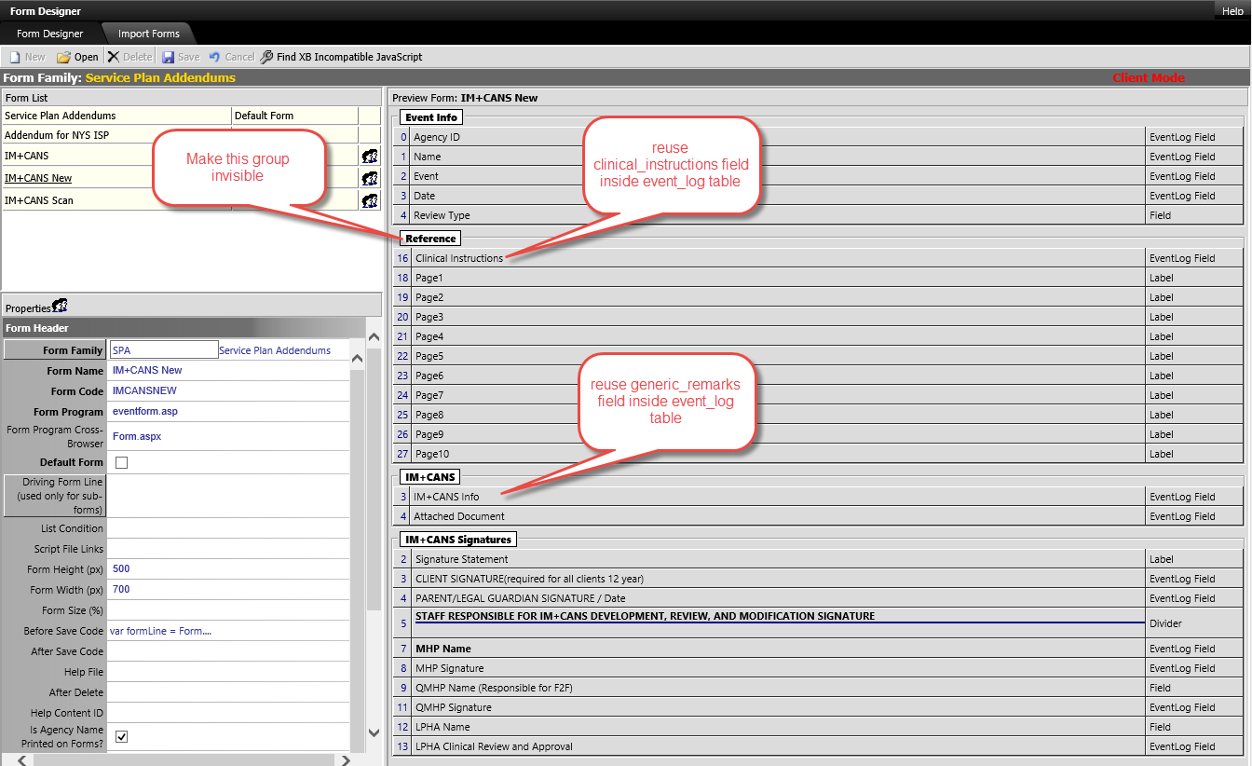
We create a ‘Reference’ group and make it invisible
Create 10 Label fields make it feel and like the IM+CANS
Repurpose clinical_instructions and type is remark, we will use this field to save all the checkbox/radio box check status.
Repurpose generic_remarks and the type is memo, we use this as the main IM+CANS info holder.

Slide 33
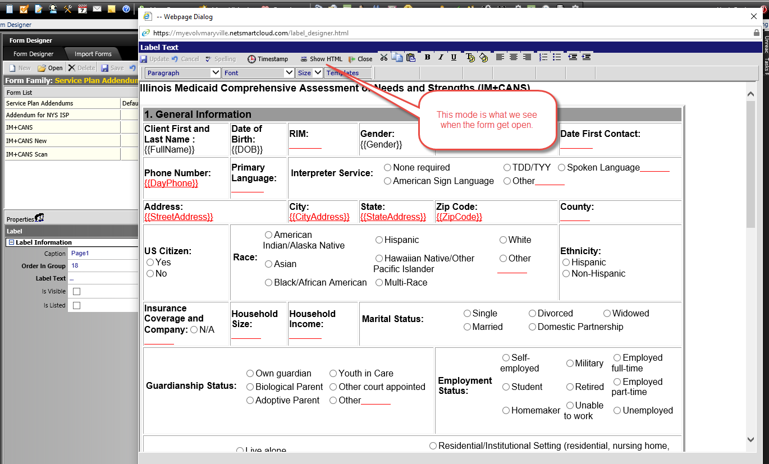
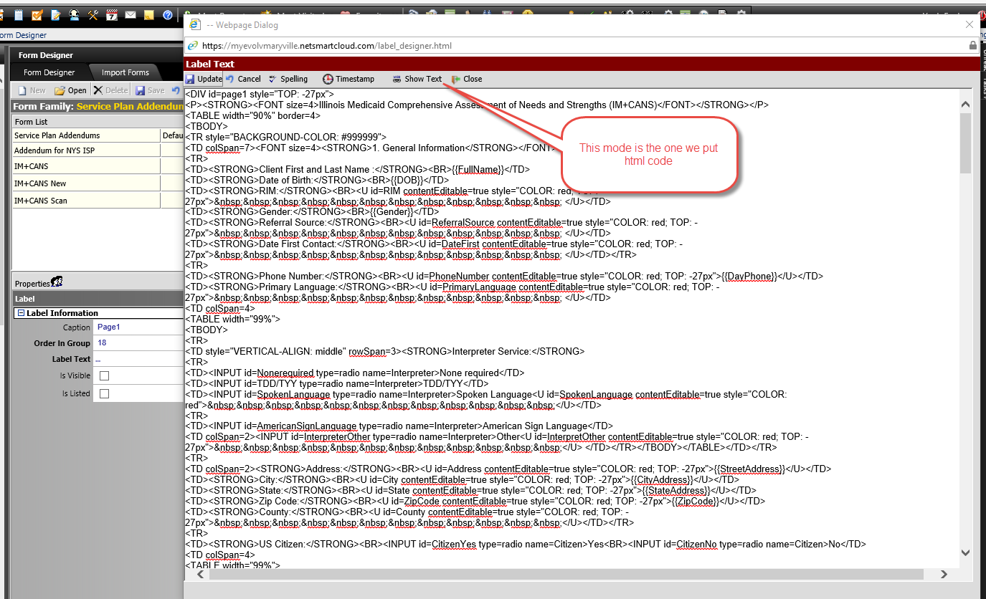
Create the label field when it is in ‘Show Text’ mode.
Every input(Checkbox, Radio button and free typing string) all have a unique ID associate with them so we can know where did they located inside this form.
Every free typing string are mark as underline and color as red and control by contentEditable attribute – decide whether they are editable or not.
Notes:
// This is what it look like for one of the label field
<DIV id=page1> <P><STRONG><FONT size=4>Illinois Medicaid Comprehensive Assessment of Needs and Strengths (IM+CANS)</FONT></STRONG></P> <TABLE width="90%" border=4> <TBODY> <TR style="BACKGROUND-COLOR: #999999"> <TD colSpan=7><FONT size=4><STRONG>1. General Information</STRONG></FONT></TD></TR> <TR> <TD><STRONG>Client First and Last Name :</STRONG><BR>{{FullName}}</TD> <TD><STRONG>Date of Birth:</STRONG><BR>{{DOB}}</TD> <TD><STRONG>RIN:</STRONG><BR><U id=RIM contentEditable=true style="COLOR: red">&nbsp;&nbsp;&nbsp;&nbsp;&nbsp;&nbsp;&nbsp;&nbsp;&nbsp;&nbsp;&nbsp;&nbsp; </U></TD> <TD><STRONG>Gender:</STRONG><BR>{{Gender}}</TD> <TD><STRONG>Referral Source:</STRONG><BR><U id=ReferralSource contentEditable=true style="COLOR: red">&nbsp;&nbsp;&nbsp;&nbsp;&nbsp;&nbsp;&nbsp;&nbsp;&nbsp;&nbsp;&nbsp;&nbsp; </U></TD> <TD><STRONG>Date First Contact:</STRONG><BR><U id=DateFirst contentEditable=true style="COLOR: red">&nbsp;&nbsp;&nbsp;&nbsp;&nbsp;&nbsp;&nbsp;&nbsp;&nbsp;&nbsp;&nbsp;&nbsp; </U></TD></TR> <TR> <TD><STRONG>Phone Number:</STRONG><BR><U id=PhoneNumber contentEditable=true style="COLOR: red">{{DayPhone}}</U></TD> <TD><STRONG>Primary Language:</STRONG><BR><U id=PrimaryLanguage contentEditable=true style="COLOR: red">&nbsp;&nbsp;&nbsp;&nbsp;&nbsp;&nbsp;&nbsp;&nbsp;&nbsp;&nbsp;&nbsp;&nbsp; </U></TD> <TD colSpan=4> <TABLE width="99%"> <TBODY> <TR> <TD style="VERTICAL-ALIGN: middle" rowSpan=3><STRONG>Interpreter Service:</STRONG> <TR> <TD><INPUT id=Nonerequired type=checkbox name=Interpreter>None required</TD> <TD><INPUT id=TDD/TYY type=checkbox name=Interpreter>TDD/TYY</TD> <TD><INPUT id=SpokenLanguage type=checkbox name=Interpreter>Spoken Language<U id=SpokenLanguage contentEditable=true style="COLOR: red">&nbsp;&nbsp;&nbsp;&nbsp;&nbsp;&nbsp;&nbsp;&nbsp;&nbsp;&nbsp;&nbsp;&nbsp;</U></TD> <TR> <TD><INPUT id=AmericanSignLanguage type=checkbox name=Interpreter>American Sign Language</TD> <TD colSpan=2><INPUT id=InterpreterOther type=checkbox name=Interpreter>Other<U id=InterpretOther contentEditable=true style="COLOR: red">&nbsp;&nbsp;&nbsp;&nbsp;&nbsp;&nbsp;&nbsp;&nbsp;&nbsp;&nbsp;&nbsp;&nbsp;</U> </TD></TR></TBODY></TABLE></TD></TR> <TR> <TD colSpan=2><STRONG>Address:</STRONG><BR><U id=Address contentEditable=true style="COLOR: red">{{StreetAddress}}</U></TD> <TD><STRONG>City:</STRONG><BR><U id=City contentEditable=true style="COLOR: red">{{CityAddress}}</U></TD> <TD><STRONG>State:</STRONG><BR><U id=State contentEditable=true style="COLOR: red">{{StateAddress}}</U></TD> <TD><STRONG>Zip Code:</STRONG><BR><U id=ZipCode contentEditable=true style="COLOR: red">{{ZipCode}}</U></TD> <TD><STRONG>County:</STRONG><BR><U id=County contentEditable=true style="COLOR: red">&nbsp;&nbsp;&nbsp;&nbsp;&nbsp;&nbsp;&nbsp;&nbsp;&nbsp;&nbsp;&nbsp;&nbsp;</U></TD></TR> <TR> <TD><STRONG>US Citizen:</STRONG><BR><INPUT id=CitizenYes type=radio name=Citizen>Yes<BR><INPUT id=CitizenNo type=radio name=Citizen>No</TD> <TD colSpan=4> <TABLE width="99%"> <TBODY> <TR> <TD style="VERTICAL-ALIGN: middle" rowSpan=4><STRONG>Race:</STRONG> <TR> <TD><INPUT id=AmericanIndian type=radio name=Race>American Indian/Alaska Native</TD> <TD><INPUT id=RaceHispanic type=radio name=Race>Hispanic</TD> <TD><INPUT id=RaceWhite type=radio name=Race>White</TD> <TR> <TD><INPUT id=RaceAsian type=radio name=Race>Asian</TD> <TD><INPUT id=HawaiianNative type=radio name=Race>Hawaiian Native/Other Pacific Islander</TD> <TD colSpan=2><INPUT id=RaceOther type=radio name=Race>Other<U id=ROther contentEditable=true style="COLOR: red">&nbsp;&nbsp;&nbsp;&nbsp;&nbsp;&nbsp;&nbsp;&nbsp;&nbsp;&nbsp;&nbsp;&nbsp;</U> </TD></TR> <TR> <TD><INPUT id=RaceBlack type=radio name=Race>Black/African American</TD> <TD><INPUT id=Multi-Race type=radio name=Race>Multi-Race</TD></TR></TBODY></TABLE></TD> <TD><STRONG>Ethnicity:</STRONG><BR><INPUT id=EthnicityHispanic type=radio name=Ethnicity>Hispanic<BR><INPUT id=EthnicityNon type=radio name=Ethnicity>Non-Hispanic</TD></TR> <TR> <TD><STRONG>Insurance Coverage and Company:</STRONG><INPUT id=Insurancena type=radio name=Insurance>N/A<BR><U contentEditable=true style="COLOR: red">&nbsp;&nbsp;&nbsp;&nbsp;&nbsp;&nbsp;&nbsp;&nbsp;&nbsp;&nbsp;&nbsp;&nbsp;</U></TD> <TD><STRONG>Household Size:</STRONG><BR><U id=HouseholdSize contentEditable=true style="COLOR: red">&nbsp;&nbsp;&nbsp;&nbsp;&nbsp;&nbsp;&nbsp;&nbsp;&nbsp;&nbsp;&nbsp;&nbsp;</U></TD> <TD><STRONG>Household Income:</STRONG><BR><U id=HouseholdIncome contentEditable=true style="COLOR: red">&nbsp;&nbsp;&nbsp;&nbsp;&nbsp;&nbsp;&nbsp;&nbsp;&nbsp;&nbsp;&nbsp;&nbsp; </U></TD> <TD colSpan=4> <TABLE width="99%"> <TBODY> <TR> <TD style="VERTICAL-ALIGN: middle" rowSpan=3><STRONG>Marital Status:</STRONG> <TR> <TD><INPUT id=MaritalSingle type=radio name=Marital>Single</TD> <TD><INPUT id=MaritalDivorced type=radio name=Marital>Divorced</TD> <TD><INPUT id=MaritalWidowed type=radio name=Marital>Widowed</TD> <TR> <TD><INPUT id=MaritalMarried type=radio name=Marital>Married</TD> <TD colSpan=2><INPUT id=MaritalDomestic type=radio name=Marital>Domestic Partnership </TD></TR></TBODY></TABLE></TD> <TR> <TD colSpan=4> <TABLE width="99%"> <TBODY> <TR> <TD style="VERTICAL-ALIGN: middle" rowSpan=4><STRONG>Guardianship Status:</STRONG> </TD> <TR> <TD><INPUT id=GuardianshipOwn type=radio name=Guardianship>Own guardian</TD> <TD><INPUT id=GuardianshipYouth type=radio name=Guardianship>Youth in Care</TD></TR> <TR> <TD><INPUT id=GuardianshipBiological type=radio name=Guardianship>Biological Parent</TD> <TD><INPUT id=GuardianshipOther type=radio name=Guardianship>Other court appointed</TD></TR> <TR> <TD><INPUT id=GuardianshipAdoptive type=radio name=Guardianship>Adoptive Parent</TD> <TD><INPUT id=GuardianshipOther type=radio name=Guardianship>Other<U id=GuardianOther contentEditable=true style="COLOR: red">&nbsp;&nbsp;&nbsp;&nbsp;&nbsp;&nbsp;&nbsp;&nbsp;&nbsp;&nbsp;&nbsp;&nbsp;</U></TD></TR></TBODY></TABLE> <TD colSpan=4> <TABLE width="99%"> <TBODY> <TR> <TD style="VERTICAL-ALIGN: middle" rowSpan=4><STRONG>Employment Status:</STRONG></TD> <TR> <TD><INPUT id=EmploymentSelf type=radio name=Employment>Self-employed</TD> <TD><INPUT id=EmploymentMilitary type=radio name=Employment>Military</TD> <TD><INPUT id=Employmentfull type=radio name=Employment>Employed full-time</TD></TR> <TR> <TD><INPUT id=EmploymentStudent type=radio name=Employment>Student</TD> <TD><INPUT id=EmploymentRetired type=radio name=Employment>Retired</TD> <TD><INPUT id=Employmentpart type=radio name=Employment>Employed part-time</TD></TR> <TR> <TD><INPUT id=EmploymentHomemaker type=radio name=Employment>Homemaker</TD> <TD><INPUT id=EmploymentUnable type=radio name=Employment>Unable to work</TD> <TD><INPUT id=EmploymentUn type=radio name=Employment>Unemployed</TD></TR></TBODY></TABLE></TD></TR> <TR> <TD colSpan=6> <TABLE width="99%"> <TBODY> <TR> <TD style="VERTICAL-ALIGN: middle" rowSpan=6><STRONG>Living Arrangement:</STRONG> </TD> <TR> <TD><INPUT id=Livingalone type=radio name=Living>Live alone</TD> <TD><INPUT id=LivingRes type=radio name=Living>Residential/Institutional Setting (residential, nursing home, shelter)</TD></TR> <TR> <TD><INPUT id=LivingInd type=radio name=Living>Independent Living</TD> <TD><INPUT id=LivingComm type=radio name=Living>Community integrated living arrangement (CILA)</TD></TR> <TR> <TD><INPUT id=LivingPar type=radio name=Living>Lives with parent(s), relative(s), or guardian(s)</TD> <TD><INPUT id=LivingFoster type=radio name=Living>Foster Care</TD></TR> <TR> <TD><INPUT id=LivingState type=radio name=Living>State operated facility (mental health/dev. disability)</TD> <TD><INPUT id=LivingHomeless type=radio name=Living>Homeless</TD></TR> <TR> <TD><INPUT id=LivingJail type=radio name=Living>Jail or correctional facility</TD> <TD><INPUT id=LivingOther type=radio name=Living>Other<U id=LivOther contentEditable=true style="COLOR: red">&nbsp;&nbsp;&nbsp;&nbsp;&nbsp;&nbsp;&nbsp;&nbsp;&nbsp;&nbsp;&nbsp;&nbsp;</U></TD></TR></TBODY></TABLE></TD></TR> <TR> <TD colSpan=6> <TABLE width="99%"> <TBODY> <TR> <TD style="VERTICAL-ALIGN: middle" rowSpan=4><STRONG>Education Level:</STRONG>(Last completed)</TD> <TR> <TD><INPUT id=EducationNever type=radio name=Education>Never attended</TD> <TD><INPUT id=Education4 type=radio name=Education>Grade 4 - 5</TD> <TD><INPUT id=EducationHS type=radio name=Education>H.S. diploma/GED</TD> <TD><INPUT id=EducationTrade type=radio name=Education>Trade/technical training</TD> <TD><INPUT id=Education type=radio name=Education Master>Master's/Doctoral degree</TD></TR> <TR> <TD><INPUT id=EducationPre type=radio name=Education>Pre-K/Kindergaten</TD> <TD><INPUT id=Education6 type=radio name=Education>Grade 6 - 8</TD> <TD><INPUT id=Educationcoll type=radio name=Education>Some college</TD> <TD><INPUT type=radio name=Education>Professional certificate</TD></TR> <TR> <TD><INPUT id=Education1 type=radio name=Education>Grade 1 - 3</TD> <TD><INPUT id=Education9 type=radio name=Education>Grade 9 - 12</TD> <TD><INPUT id=EducationAssociate type=radio name=Education>Associate's degree</TD> <TD><INPUT id=EducationBachelor type=radio name=Education>Bachelor's degree</TD></TR></TBODY></TABLE></TD></TR> <TR> <TD style="VERTICAL-ALIGN: middle" rowSpan=2><STRONG>Parent, Guardian or Significant Other Info:</STRONG> <TD colSpan=2><STRONG>First and Last Name :</STRONG><BR><U id=parentName contentEditable=true style="COLOR: red">&nbsp;&nbsp;&nbsp;&nbsp;&nbsp;&nbsp;&nbsp;&nbsp;&nbsp;&nbsp;&nbsp;&nbsp;</U></TD> <TD colSpan=2><STRONG>Relationship to Client:</STRONG><BR><INPUT id=ParentGuardianP type=radio name=ParentGuardian>Parent<INPUT id=ParentGuardianG type=radio name=ParentGuardian>Guardian<INPUT id=ParentGuardianO type=radio name=ParentGuardian>Significant Other</TD> <TD><STRONG>Phone Number:</STRONG><BR><U id=parentPhone contentEditable=true style="COLOR: red">&nbsp;&nbsp;&nbsp;&nbsp;&nbsp;&nbsp;&nbsp;&nbsp;&nbsp;&nbsp;&nbsp;&nbsp;</U></TD></TR> <TR> <TD><STRONG>Address:</STRONG><BR><U id=parentAddress contentEditable=true style="COLOR: red">&nbsp;&nbsp;&nbsp;&nbsp;&nbsp;&nbsp;&nbsp;&nbsp;&nbsp;&nbsp;&nbsp;&nbsp;</U></TD> <TD><STRONG>City:</STRONG><BR><U id=parentCity contentEditable=true style="COLOR: red">&nbsp;&nbsp;&nbsp;&nbsp;&nbsp;&nbsp;&nbsp;&nbsp;&nbsp;&nbsp;&nbsp;&nbsp;</U></TD> <TD><STRONG>State:</STRONG><BR><U id=parentState contentEditable=true style="COLOR: red">&nbsp;&nbsp;&nbsp;&nbsp;&nbsp;&nbsp;&nbsp;&nbsp;&nbsp;&nbsp;&nbsp;&nbsp;</U></TD> <TD><STRONG>Zip Code:</STRONG><BR><U id=parentZip contentEditable=true style="COLOR: red">&nbsp;&nbsp;&nbsp;&nbsp;&nbsp;&nbsp;&nbsp;&nbsp;&nbsp;&nbsp;&nbsp;&nbsp;</U></TD> <TD><STRONG>County:</STRONG><BR><U id=parentCOunty contentEditable=true style="COLOR: red">&nbsp;&nbsp;&nbsp;&nbsp;&nbsp;&nbsp;&nbsp;&nbsp;&nbsp;&nbsp;&nbsp;&nbsp;</U></TD></TR> <TR> <TD style="VERTICAL-ALIGN: middle" rowSpan=2><STRONG>Emergency Contact Info:</STRONG> <TD colSpan=2><STRONG>First and Last Name :</STRONG><BR><U id=contactname contentEditable=true style="COLOR: red">&nbsp;&nbsp;&nbsp;&nbsp;&nbsp;&nbsp;&nbsp;&nbsp;&nbsp;&nbsp;&nbsp;&nbsp;</U></TD> <TD colSpan=2><STRONG>Relationship to Client:</STRONG><BR><U id=contactrelation contentEditable=true style="COLOR: red">&nbsp;&nbsp;&nbsp;&nbsp;&nbsp;&nbsp;&nbsp;&nbsp;&nbsp;&nbsp;&nbsp;&nbsp;</U> <TD><STRONG>Phone Number:</STRONG><BR><U id=contactphone contentEditable=true style="COLOR: red">&nbsp;&nbsp;&nbsp;&nbsp;&nbsp;&nbsp;&nbsp;&nbsp;&nbsp;&nbsp;&nbsp;&nbsp;</U></TD></TR> <TR> <TD><STRONG>Address:</STRONG><BR><U id=contactAddress contentEditable=true style="COLOR: red">&nbsp;&nbsp;&nbsp;&nbsp;&nbsp;&nbsp;&nbsp;&nbsp;&nbsp;&nbsp;&nbsp;&nbsp;</U></TD> <TD><STRONG>City:</STRONG><BR><U id=contactCity contentEditable=true style="COLOR: red">&nbsp;&nbsp;&nbsp;&nbsp;&nbsp;&nbsp;&nbsp;&nbsp;&nbsp;&nbsp;&nbsp;&nbsp;</U></TD> <TD><STRONG>State:</STRONG><BR><U id=contactState contentEditable=true style="COLOR: red">&nbsp;&nbsp;&nbsp;&nbsp;&nbsp;&nbsp;&nbsp;&nbsp;&nbsp;&nbsp;&nbsp;&nbsp;</U></TD> <TD><STRONG>Zip Code:</STRONG><BR><U id=contactZip contentEditable=true style="COLOR: red">&nbsp;&nbsp;&nbsp;&nbsp;&nbsp;&nbsp;&nbsp;&nbsp;&nbsp;&nbsp;&nbsp;&nbsp;</U></TD> <TD><STRONG>County:</STRONG><BR><U id=contactCounty contentEditable=true style="COLOR: red">&nbsp;&nbsp;&nbsp;&nbsp;&nbsp;&nbsp;&nbsp;&nbsp;&nbsp;&nbsp;&nbsp;&nbsp;</U></TD></TR> <TR> <TD style="VERTICAL-ALIGN: middle"><STRONG>Members of Family Constellation:</STRONG> <TD colSpan=5> <TABLE width="99%" border=1> <TBODY> <TR style="BACKGROUND-COLOR: #999999"> <TD><STRONG>Name</STRONG></TD> <TD><STRONG>Age</STRONG></TD> <TD><STRONG>Relation to Client</STRONG></TD> <TD><STRONG>Living in Home</STRONG></TD></TR> <TR> <TD><U id=ConstellationN1 contentEditable=true style="COLOR: red">&nbsp;&nbsp;&nbsp;&nbsp;&nbsp;&nbsp;&nbsp;&nbsp;&nbsp;&nbsp;&nbsp;&nbsp;</U></TD> <TD><U id=ConstellationA1 contentEditable=true style="COLOR: red">&nbsp;&nbsp;&nbsp;&nbsp;&nbsp;&nbsp;&nbsp;&nbsp;&nbsp;&nbsp;&nbsp;&nbsp;</U></TD> <TD><U id=ConstellationR1 contentEditable=true style="COLOR: red">&nbsp;&nbsp;&nbsp;&nbsp;&nbsp;&nbsp;&nbsp;&nbsp;&nbsp;&nbsp;&nbsp;&nbsp;</U></TD> <TD><INPUT id=Member1Y type=radio name=Member1>Yes<INPUT id=Member1N type=radio name=Member1>No</TD></TR> <TR> <TD><U id=ConstellationN2 contentEditable=true style="COLOR: red">&nbsp;&nbsp;&nbsp;&nbsp;&nbsp;&nbsp;&nbsp;&nbsp;&nbsp;&nbsp;&nbsp;&nbsp;</U></TD> <TD><U id=ConstellationA2 contentEditable=true style="COLOR: red">&nbsp;&nbsp;&nbsp;&nbsp;&nbsp;&nbsp;&nbsp;&nbsp;&nbsp;&nbsp;&nbsp;&nbsp;</U></TD> <TD><U id=ConstellationR2 contentEditable=true style="COLOR: red">&nbsp;&nbsp;&nbsp;&nbsp;&nbsp;&nbsp;&nbsp;&nbsp;&nbsp;&nbsp;&nbsp;&nbsp;</U></TD> <TD><INPUT id=Member2Y type=radio name=Member2>Yes<INPUT id=Member2N type=radio name=Member2>No</TD></TR> <TR> <TD><U id=ConstellationN3 contentEditable=true style="COLOR: red">&nbsp;&nbsp;&nbsp;&nbsp;&nbsp;&nbsp;&nbsp;&nbsp;&nbsp;&nbsp;&nbsp;&nbsp;</U></TD> <TD><U id=ConstellationA3 contentEditable=true style="COLOR: red">&nbsp;&nbsp;&nbsp;&nbsp;&nbsp;&nbsp;&nbsp;&nbsp;&nbsp;&nbsp;&nbsp;&nbsp;</U></TD> <TD><U id=ConstellationR3 contentEditable=true style="COLOR: red">&nbsp;&nbsp;&nbsp;&nbsp;&nbsp;&nbsp;&nbsp;&nbsp;&nbsp;&nbsp;&nbsp;&nbsp;</U></TD> <TD><INPUT id=Member3Y type=radio name=Member3>Yes<INPUT id=Member3N type=radio name=Member3>No</TD></TR> <TR> <TD><U id=ConstellationN4 contentEditable=true style="COLOR: red">&nbsp;&nbsp;&nbsp;&nbsp;&nbsp;&nbsp;&nbsp;&nbsp;&nbsp;&nbsp;&nbsp;&nbsp;</U></TD> <TD><U id=ConstellationA4 contentEditable=true style="COLOR: red">&nbsp;&nbsp;&nbsp;&nbsp;&nbsp;&nbsp;&nbsp;&nbsp;&nbsp;&nbsp;&nbsp;&nbsp;</U></TD> <TD><U id=ConstellationR4 contentEditable=true style="COLOR: red">&nbsp;&nbsp;&nbsp;&nbsp;&nbsp;&nbsp;&nbsp;&nbsp;&nbsp;&nbsp;&nbsp;&nbsp;</U></TD> <TD><INPUT id=Member4Y type=radio name=Member4>Yes<INPUT id=Member4N type=radio name=Member4>No</TD></TR> <TR> <TD><U id=ConstellationN5 contentEditable=true style="COLOR: red">&nbsp;&nbsp;&nbsp;&nbsp;&nbsp;&nbsp;&nbsp;&nbsp;&nbsp;&nbsp;&nbsp;&nbsp;</U></TD> <TD><U id=ConstellationA5 contentEditable=true style="COLOR: red">&nbsp;&nbsp;&nbsp;&nbsp;&nbsp;&nbsp;&nbsp;&nbsp;&nbsp;&nbsp;&nbsp;&nbsp;</U></TD> <TD><U id=ConstellationR% contentEditable=true style="COLOR: red">&nbsp;&nbsp;&nbsp;&nbsp;&nbsp;&nbsp;&nbsp;&nbsp;&nbsp;&nbsp;&nbsp;&nbsp;</U></TD> <TD><INPUT id=Member5Y type=radio name=Member5>Yes<INPUT id=Member5N type=radio name=Member5>No</TD></TR> <TR> <TD><U id=ConstellationN6 contentEditable=true style="COLOR: red">&nbsp;&nbsp;&nbsp;&nbsp;&nbsp;&nbsp;&nbsp;&nbsp;&nbsp;&nbsp;&nbsp;&nbsp;</U></TD> <TD><U id=ConstellationA6 contentEditable=true style="COLOR: red">&nbsp;&nbsp;&nbsp;&nbsp;&nbsp;&nbsp;&nbsp;&nbsp;&nbsp;&nbsp;&nbsp;&nbsp;</U></TD> <TD><U id=ConstellationR6 contentEditable=true style="COLOR: red">&nbsp;&nbsp;&nbsp;&nbsp;&nbsp;&nbsp;&nbsp;&nbsp;&nbsp;&nbsp;&nbsp;&nbsp;</U></TD> <TD><INPUT id=Member6Y type=radio name=Member6>Yes<INPUT id=Member6N type=radio name=Member6>No</TD></TR> <TR> <TD><U id=ConstellationN7 contentEditable=true style="COLOR: red">&nbsp;&nbsp;&nbsp;&nbsp;&nbsp;&nbsp;&nbsp;&nbsp;&nbsp;&nbsp;&nbsp;&nbsp;</U></TD> <TD><U id=ConstellationA7 contentEditable=true style="COLOR: red">&nbsp;&nbsp;&nbsp;&nbsp;&nbsp;&nbsp;&nbsp;&nbsp;&nbsp;&nbsp;&nbsp;&nbsp;</U></TD> <TD><U id=ConstellationR7 contentEditable=true style="COLOR: red">&nbsp;&nbsp;&nbsp;&nbsp;&nbsp;&nbsp;&nbsp;&nbsp;&nbsp;&nbsp;&nbsp;&nbsp;</U></TD> <TD><INPUT id=Member7Y type=radio name=Member7>Yes<INPUT id=Member7N type=radio name=Member7>No</TD></TR> <TR> <TD><U id=ConstellationN8 contentEditable=true style="COLOR: red">&nbsp;&nbsp;&nbsp;&nbsp;&nbsp;&nbsp;&nbsp;&nbsp;&nbsp;&nbsp;&nbsp;&nbsp;</U></TD> <TD><U id=ConstellationA8 contentEditable=true style="COLOR: red">&nbsp;&nbsp;&nbsp;&nbsp;&nbsp;&nbsp;&nbsp;&nbsp;&nbsp;&nbsp;&nbsp;&nbsp;</U></TD> <TD><U id=ConstellationR8 contentEditable=true style="COLOR: red">&nbsp;&nbsp;&nbsp;&nbsp;&nbsp;&nbsp;&nbsp;&nbsp;&nbsp;&nbsp;&nbsp;&nbsp;</U></TD> <TD><INPUT id=Member8Y type=radio name=Member8>Yes<INPUT id=Member8N type=radio name=Member8>No</TD></TR> <TR> <TD><U id=ConstellationN9 contentEditable=true style="COLOR: red">&nbsp;&nbsp;&nbsp;&nbsp;&nbsp;&nbsp;&nbsp;&nbsp;&nbsp;&nbsp;&nbsp;&nbsp;</U></TD> <TD><U id=ConstellationA9 contentEditable=true style="COLOR: red">&nbsp;&nbsp;&nbsp;&nbsp;&nbsp;&nbsp;&nbsp;&nbsp;&nbsp;&nbsp;&nbsp;&nbsp;</U></TD> <TD><U id=ConstellationR9 contentEditable=true style="COLOR: red">&nbsp;&nbsp;&nbsp;&nbsp;&nbsp;&nbsp;&nbsp;&nbsp;&nbsp;&nbsp;&nbsp;&nbsp;</U></TD> <TD><INPUT id=Member9Y type=radio name=Member9>Yes<INPUT id=Member9N type=radio name=Member9>No</TD></TR></TBODY></TABLE></TD></TR> <TR style="BACKGROUND-COLOR: #999999"> <TD colSpan=2><STRONG>Established Supports</STRONG></TD> <TD><STRONG>Agency</STRONG></TD> <TD><STRONG>Contact Name</STRONG></TD> <TD><STRONG>Phone</STRONG></TD> <TD><STRONG>Email</STRONG></TD></TR> <TR> <TD colSpan=2><STRONG>Physician</STRONG></TD> <TD><U id=EstablishedA1 contentEditable=true style="COLOR: red">&nbsp;&nbsp;&nbsp;&nbsp;&nbsp;&nbsp;&nbsp;&nbsp;&nbsp;&nbsp;&nbsp;&nbsp;</U></TD> <TD><U id=EstablishedC1 contentEditable=true style="COLOR: red">&nbsp;&nbsp;&nbsp;&nbsp;&nbsp;&nbsp;&nbsp;&nbsp;&nbsp;&nbsp;&nbsp;&nbsp;</U></TD> <TD><U id=EstablishedP1 contentEditable=true style="COLOR: red">&nbsp;&nbsp;&nbsp;&nbsp;&nbsp;&nbsp;&nbsp;&nbsp;&nbsp;&nbsp;&nbsp;&nbsp;</U></TD> <TD><U id=EstablishedE1 contentEditable=true style="COLOR: red">&nbsp;&nbsp;&nbsp;&nbsp;&nbsp;&nbsp;&nbsp;&nbsp;&nbsp;&nbsp;&nbsp;&nbsp;</U></TD></TR> <TR> <TD colSpan=2><STRONG>School/Daycare</STRONG></TD> <TD><U id=EstablishedA2 contentEditable=true style="COLOR: red">&nbsp;&nbsp;&nbsp;&nbsp;&nbsp;&nbsp;&nbsp;&nbsp;&nbsp;&nbsp;&nbsp;&nbsp;</U></TD> <TD><U id=EstablishedC2 contentEditable=true style="COLOR: red">&nbsp;&nbsp;&nbsp;&nbsp;&nbsp;&nbsp;&nbsp;&nbsp;&nbsp;&nbsp;&nbsp;&nbsp;</U></TD> <TD><U id=EstablishedP2 contentEditable=true style="COLOR: red">&nbsp;&nbsp;&nbsp;&nbsp;&nbsp;&nbsp;&nbsp;&nbsp;&nbsp;&nbsp;&nbsp;&nbsp;</U></TD> <TD><U id=EstablishedE2 contentEditable=true style="COLOR: red">&nbsp;&nbsp;&nbsp;&nbsp;&nbsp;&nbsp;&nbsp;&nbsp;&nbsp;&nbsp;&nbsp;&nbsp;</U></TD></TR> <TR> <TD colSpan=2><STRONG>Counselor/Therapist</STRONG></TD> <TD><U id=EstablishedA3 contentEditable=true style="COLOR: red">&nbsp;&nbsp;&nbsp;&nbsp;&nbsp;&nbsp;&nbsp;&nbsp;&nbsp;&nbsp;&nbsp;&nbsp;</U></TD> <TD><U id=EstablishedC3 contentEditable=true style="COLOR: red">&nbsp;&nbsp;&nbsp;&nbsp;&nbsp;&nbsp;&nbsp;&nbsp;&nbsp;&nbsp;&nbsp;&nbsp;</U></TD> <TD><U id=EstablishedP3 contentEditable=true style="COLOR: red">&nbsp;&nbsp;&nbsp;&nbsp;&nbsp;&nbsp;&nbsp;&nbsp;&nbsp;&nbsp;&nbsp;&nbsp;</U></TD> <TD><U id=EstablishedE3 contentEditable=true style="COLOR: red">&nbsp;&nbsp;&nbsp;&nbsp;&nbsp;&nbsp;&nbsp;&nbsp;&nbsp;&nbsp;&nbsp;&nbsp;</U></TD></TR> <TR> <TD colSpan=2><STRONG>Child Welfare Worker</STRONG></TD> <TD><U id=EstablishedA4 contentEditable=true style="COLOR: red">&nbsp;&nbsp;&nbsp;&nbsp;&nbsp;&nbsp;&nbsp;&nbsp;&nbsp;&nbsp;&nbsp;&nbsp;</U></TD> <TD><U id=EstablishedC4 contentEditable=true style="COLOR: red">&nbsp;&nbsp;&nbsp;&nbsp;&nbsp;&nbsp;&nbsp;&nbsp;&nbsp;&nbsp;&nbsp;&nbsp;</U></TD> <TD><U id=EstablishedP4 contentEditable=true style="COLOR: red">&nbsp;&nbsp;&nbsp;&nbsp;&nbsp;&nbsp;&nbsp;&nbsp;&nbsp;&nbsp;&nbsp;&nbsp;</U></TD> <TD><U id=EstablishedE4 contentEditable=true style="COLOR: red">&nbsp;&nbsp;&nbsp;&nbsp;&nbsp;&nbsp;&nbsp;&nbsp;&nbsp;&nbsp;&nbsp;&nbsp;</U></TD></TR> <TR> <TD colSpan=2><STRONG>ISC/PAS Agent</STRONG></TD> <TD><U id=EstablishedA5 contentEditable=true style="COLOR: red">&nbsp;&nbsp;&nbsp;&nbsp;&nbsp;&nbsp;&nbsp;&nbsp;&nbsp;&nbsp;&nbsp;&nbsp;</U></TD> <TD><U id=EstablishedC5 contentEditable=true style="COLOR: red">&nbsp;&nbsp;&nbsp;&nbsp;&nbsp;&nbsp;&nbsp;&nbsp;&nbsp;&nbsp;&nbsp;&nbsp;</U></TD> <TD><U id=EstablishedP5 contentEditable=true style="COLOR: red">&nbsp;&nbsp;&nbsp;&nbsp;&nbsp;&nbsp;&nbsp;&nbsp;&nbsp;&nbsp;&nbsp;&nbsp;</U></TD> <TD><U id=EstablishedE5 contentEditable=true style="COLOR: red">&nbsp;&nbsp;&nbsp;&nbsp;&nbsp;&nbsp;&nbsp;&nbsp;&nbsp;&nbsp;&nbsp;&nbsp;</U></TD></TR> <TR> <TD colSpan=2><STRONG>Probation Officer</STRONG></TD> <TD><U id=EstablishedA6 contentEditable=true style="COLOR: red">&nbsp;&nbsp;&nbsp;&nbsp;&nbsp;&nbsp;&nbsp;&nbsp;&nbsp;&nbsp;&nbsp;&nbsp;</U></TD> <TD><U id=EstablishedC6 contentEditable=true style="COLOR: red">&nbsp;&nbsp;&nbsp;&nbsp;&nbsp;&nbsp;&nbsp;&nbsp;&nbsp;&nbsp;&nbsp;&nbsp;</U></TD> <TD><U id=EstablishedP6 contentEditable=true style="COLOR: red">&nbsp;&nbsp;&nbsp;&nbsp;&nbsp;&nbsp;&nbsp;&nbsp;&nbsp;&nbsp;&nbsp;&nbsp;</U></TD> <TD><U id=EstablishedE6 contentEditable=true style="COLOR: red">&nbsp;&nbsp;&nbsp;&nbsp;&nbsp;&nbsp;&nbsp;&nbsp;&nbsp;&nbsp;&nbsp;&nbsp;</U></TD></TR> <TR> <TD colSpan=2><STRONG>Other:<U id=EstablishedOther1 contentEditable=true style="COLOR: red">&nbsp;&nbsp;&nbsp;&nbsp;&nbsp;&nbsp;&nbsp;&nbsp;&nbsp;&nbsp;&nbsp;&nbsp;</U></STRONG></TD> <TD><U id=EstablishedA7 contentEditable=true style="COLOR: red">&nbsp;&nbsp;&nbsp;&nbsp;&nbsp;&nbsp;&nbsp;&nbsp;&nbsp;&nbsp;&nbsp;&nbsp;</U></TD> <TD><U id=EstablishedC7 contentEditable=true style="COLOR: red">&nbsp;&nbsp;&nbsp;&nbsp;&nbsp;&nbsp;&nbsp;&nbsp;&nbsp;&nbsp;&nbsp;&nbsp;</U></TD> <TD><U id=EstablishedP7 contentEditable=true style="COLOR: red">&nbsp;&nbsp;&nbsp;&nbsp;&nbsp;&nbsp;&nbsp;&nbsp;&nbsp;&nbsp;&nbsp;&nbsp;</U></TD> <TD><U id=EstablishedE7 contentEditable=true style="COLOR: red">&nbsp;&nbsp;&nbsp;&nbsp;&nbsp;&nbsp;&nbsp;&nbsp;&nbsp;&nbsp;&nbsp;&nbsp;</U></TD></TR> <TR> <TD colSpan=2><STRONG>Other:<U id=EstablishedOther2 contentEditable=true style="COLOR: red">&nbsp;&nbsp;&nbsp;&nbsp;&nbsp;&nbsp;&nbsp;&nbsp;&nbsp;&nbsp;&nbsp;&nbsp;</U></STRONG></TD> <TD><U id=EstablishedA8 contentEditable=true style="COLOR: red">&nbsp;&nbsp;&nbsp;&nbsp;&nbsp;&nbsp;&nbsp;&nbsp;&nbsp;&nbsp;&nbsp;&nbsp;</U></TD> <TD><U id=EstablishedC8 contentEditable=true style="COLOR: red">&nbsp;&nbsp;&nbsp;&nbsp;&nbsp;&nbsp;&nbsp;&nbsp;&nbsp;&nbsp;&nbsp;&nbsp;</U></TD> <TD><U id=EstablishedP8 contentEditable=true style="COLOR: red">&nbsp;&nbsp;&nbsp;&nbsp;&nbsp;&nbsp;&nbsp;&nbsp;&nbsp;&nbsp;&nbsp;&nbsp;</U></TD> <TD><U id=EstablishedE8 contentEditable=true style="COLOR: red">&nbsp;&nbsp;&nbsp;&nbsp;&nbsp;&nbsp;&nbsp;&nbsp;&nbsp;&nbsp;&nbsp;&nbsp;</U></TD></TR> <TR> <TD colSpan=2><STRONG>Other:<U id=EstablishedOther3 contentEditable=true style="COLOR: red">&nbsp;&nbsp;&nbsp;&nbsp;&nbsp;&nbsp;&nbsp;&nbsp;&nbsp;&nbsp;&nbsp;&nbsp;</U></STRONG></TD> <TD><U id=EstablishedA9 contentEditable=true style="COLOR: red">&nbsp;&nbsp;&nbsp;&nbsp;&nbsp;&nbsp;&nbsp;&nbsp;&nbsp;&nbsp;&nbsp;&nbsp;</U></TD> <TD><U id=EstablishedC9 contentEditable=true style="COLOR: red">&nbsp;&nbsp;&nbsp;&nbsp;&nbsp;&nbsp;&nbsp;&nbsp;&nbsp;&nbsp;&nbsp;&nbsp;</U></TD> <TD><U id=EstablishedP9 contentEditable=true style="COLOR: red">&nbsp;&nbsp;&nbsp;&nbsp;&nbsp;&nbsp;&nbsp;&nbsp;&nbsp;&nbsp;&nbsp;&nbsp;</U></TD> <TD><U id=EstablishedE9 contentEditable=true style="COLOR: red">&nbsp;&nbsp;&nbsp;&nbsp;&nbsp;&nbsp;&nbsp;&nbsp;&nbsp;&nbsp;&nbsp;&nbsp;</U></TD></TR></TBODY></TABLE></DIV>IM+CANS- P1

Slide 34
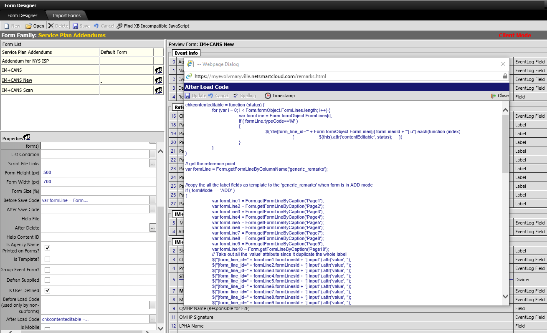
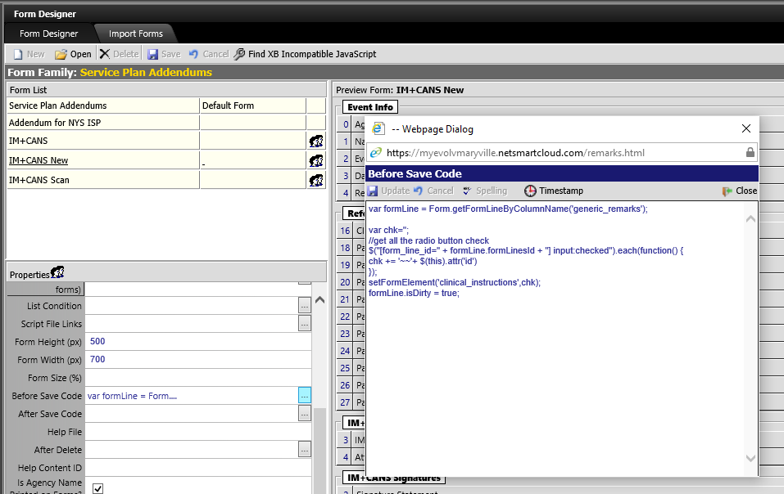
We put After Load Code into the form
We put Before Save Code into the form.
Notes:
// Before Save code
var formLine = Form.getFormLineByColumnName('generic_remarks');
var chk='';
//get all the radio button check
$("[form_line_id=" + formLine.formLinesId + "] input:checked").each(function() {
chk += '~~'+ $(this).attr('id')
});
setFormElement('clinical_instructions',chk);
// let the system know this invisible field get change so it will save it
formLine.isDirty = true;
// After Load code
chkcontenteditable = function (status) {
for (var i = 0; i < Form.formObject.FormLines.length; i++) {
var formLine = Form.formObject.FormLines[i];
if ( formLine.typeCode=='M' )
{
$("div[form_line_id='" + Form.formObject.FormLines[i].formLinesId + "'] u").each(function (index)
{ $(this).attr('contentEditable', status); })
}
}
}
// get the reference point
var formLine = Form.getFormLineByColumnName('generic_remarks');
var formLine1 = Form.getFormLineByCaption('Page1');
var formLine2 = Form.getFormLineByCaption('Page2');
var formLine3 = Form.getFormLineByCaption('Page3');
var formLine4 = Form.getFormLineByCaption('Page4');
var formLine5 = Form.getFormLineByCaption('Page5');
var formLine6 = Form.getFormLineByCaption('Page6');
var formLine7 = Form.getFormLineByCaption('Page7');
var formLine8 = Form.getFormLineByCaption('Page8');
var formLine9 = Form.getFormLineByCaption('Page9');
var formLine10 = Form.getFormLineByCaption('Page10');
//copy the all the label fields as template to the 'generic_remarks' when form is in ADD mode
if ( formMode == 'ADD' )
{
// Take out all the 'value' attribute since it will duplicate the whole label
$("[form_line_id=" + formLine1.formLinesId + "] input").attr('value', '');
$("[form_line_id=" + formLine2.formLinesId + "] input").attr('value', '');
$("[form_line_id=" + formLine3.formLinesId + "] input").attr('value', '');
$("[form_line_id=" + formLine4.formLinesId + "] input").attr('value', '');
$("[form_line_id=" + formLine5.formLinesId + "] input").attr('value', '');
$("[form_line_id=" + formLine6.formLinesId + "] input").attr('value', '');
$("[form_line_id=" + formLine7.formLinesId + "] input").attr('value', '');
$("[form_line_id=" + formLine8.formLinesId + "] input").attr('value', '');
$("[form_line_id=" + formLine9.formLinesId + "] input").attr('value', '');
$("[form_line_id=" + formLine10.formLinesId + "] input").attr('value', '');
var content='';
content += $("[form_line_id=" + formLine1.formLinesId + "] ").html();
content += $("[form_line_id=" + formLine2.formLinesId + "] ").html();
content += $("[form_line_id=" + formLine3.formLinesId + "] ").html();
content += $("[form_line_id=" + formLine4.formLinesId + "] ").html();
content += $("[form_line_id=" + formLine5.formLinesId + "] ").html();
content += $("[form_line_id=" + formLine6.formLinesId + "] ").html();
content += $("[form_line_id=" + formLine7.formLinesId + "] ").html();
content += $("[form_line_id=" + formLine8.formLinesId + "] ").html();
content += $("[form_line_id=" + formLine9.formLinesId + "] ").html();
content += $("[form_line_id=" + formLine10.formLinesId + "] ").html();
$("[form_line_id=" + formLine.formLinesId + "]").find(".note-editable").html(content);
}
$("[form_line_id=" + formLine1.formLinesId + "]").remove();
$("[form_line_id=" + formLine2.formLinesId + "]").remove();
$("[form_line_id=" + formLine3.formLinesId + "]").remove();
$("[form_line_id=" + formLine4.formLinesId + "]").remove();
$("[form_line_id=" + formLine5.formLinesId + "]").remove();
$("[form_line_id=" + formLine6.formLinesId + "]").remove();
$("[form_line_id=" + formLine7.formLinesId + "]").remove();
$("[form_line_id=" + formLine8.formLinesId + "]").remove();
$("[form_line_id=" + formLine9.formLinesId + "]").remove();
$("[form_line_id=" + formLine10.formLinesId + "]").remove();
//Make the memo field uneditable
$("[form_line_id=" + formLine.formLinesId + "]").find(".note-editable").attr('contenteditable','false');
var chk_arr = getFormElement('clinical_instructions').split("~~");
//Check all the checkbox and radio box
for (i=1; i< chk_arr.length - 1;i++)
{ $("[form_line_id=" + formLine.formLinesId + "] input[id='"+chk_arr[i]+"']").attr('checked', true); }
if ( formMode != 'VIEW' )
{// Toggle contenteditable attr by signature field change -- attach an event to the signature fields
$("body").on('DOMSubtreeModified', '[type-code="ESIGN"]', function() {
var st = 0;
attr = $(this).attr("picture-id");
if ( attr !="" && typeof attr !== "undefined" && st != 1) { st = 1 }
if (st == 1) { chkcontenteditable('false'); }
else {
chkcontenteditable('true');
$("textarea").each(function (index) {
$(this).removeAttr('disabled');
})
}
});
//Toggle the radio button
var radioState;
$("[form_line_id='" + formLine.formLinesId + "'] input:radio").on('click', function() {
if (radioState === this) {
this.checked = false;
radioState = null;
} else {
radioState = this;
}
});
$("div[form_line_id='" + formLine.formLinesId + "'] u").each(function (index)
{
$(this).attr('contenteditable','true');
$(this).css("background-color", "#d9d9d9");
if (!isNullOrWhiteSpace($(this).text()) ) {$(this).css("color", "#160029");} //black
//attach event to this editable field
$(this).focusin(function(){$(this).css("background-color", "#BDB76B");}) //green #BDB76B
$(this).focusout(function() {
$(this).css("background-color", "#FFFFFF"); //white
if (!isNullOrWhiteSpace($(this).text())) {
$(this).text($(this).text().trimStart());
if (($(this).text()).indexOf('PM') != -1 && ($(this).attr('id')).indexOf('sisrv') != -1)
{ $("[id='iamt" +($(this).attr('id')).substring(5, 7)+"']").text(' times');}
else if (($(this).text()).indexOf('PM') == -1 && ($(this).attr('id')).indexOf('sisrv') != -1)
{ $("[id='iamt" +($(this).attr('id')).substring(5, 7)+"']").text(' minutes');}
$(this).css("color", "#000000");
}
else {
$(this).css("background-color", "#BDB76B");
$(this).css("color", "#FF0000");
} //red #FF0000
})
$(this).keydown(function (e) { e.stopImmediatePropagation(); }); // enable the BackSpace
})
}

Slide 35
Case Study – How to copy info from other place
Lots of time we want to copy data from existing data.
There can be couple case
Copy from existing field inside the same form.
Copy from other place in the system.
Copy part of other form
Concept/Technique
The approach will depend what we want to do.

Slide 36
Copy from existing field inside the same form.
We can used getFormElement(name) to get the value then used setFormElement(name, formVal) to set the value
We want copy the actual_date and add 1 year to expiration_date when actual_date get choose.
//Put this into ‘On Change Code
var date = new Date(getFormElement(‘actual_date'));
date.setFullYear(date.getFullYear() + 1);
var mm = date.getMonth() + 1;
var dd = date.getDate();
var yyyy = date.getFullYear();
setFormElement(‘experiation_date’, mm + '/' + dd + '/' + yyyy;
)

Slide 37
Copy from other place in the system.
We can used getDataValue(tableFrom, codeField, codeValue, returnField, conditionExpr) to get the value then used setFormElement(name, formVal) to set the value
We want using the DOB to get the age(YYMM) against current form’s actual_date
//we put this code into ‘On Change Code’ for actual_date
var actual_date = new Date(getFormElement('actual_date'));
var dob = new Date(getDataValue('client_personal_view', 'people_id', parentValue, 'dob'));
var year = (actual_date.getFullYear() - dob.getFullYear());
var months = actual_date.getMonth() - dob.getMonth() + 1;
var days = actual_date.getDate() - dob.getDate() ;
if ( days < 0 ) { months --; }
if ( months < 0 ) { year --; months += 12 ;}
var age = year + ' Y ' + months + ' M';
setFormElement('udf_age', age);

Slide 38
Copy part of other form
Sometime you want some info that is part of other form but not all of them and you want those info show this information in current form as a reference.
Concept/Technique
We can copy part of the other form event via loading other page to current form then copy the info we want into current form.
Predefined two invisible fields(Start and End) in the original form so we know which part of form we want.
Using a getDvalue (getDataValue like) function to find the event_log_id and then find out the form_header_id so we can use those info the build the URL we want.
Load the form into a invisible variable field(defines as memo type) html content as a iframe object.
Wait the iframe get loaded and we only want get the html content that between ‘Start’ and ‘End’ from this iframe object.
Using setFormElement to set the data to a predefined memo fields(not modifiable)
Need to replace “iframe” as ‘I’ + ‘frame’( it will not allow you to save if we using iframe keyword)
Notes:
//we put this code into ‘On Change Code’ for actual_date
getDValue = function(tableFrom, codeField, codeValue, returnField, conditionExpr, orderBy)
{
var json = JSON.stringify({ table_from: tableFrom, code_field: codeField, code_value: codeValue, return_field: returnField, condition_expression: conditionExpr, order_expression: orderBy});
$.ajax({
type: "POST",
method: "POST",
dataType: "json",
contentType: "application/json; charset=utf-8",
url: "webservices/DataValueService.svc/GetDataValue",
async: false,
data: json,
success: function (data, textStatus, jqXHR) {
returnData = data;
},
error: function (jqXHR, textStatus, errorThrown) {
alert("Error trying to execute getDataValue: " + errorThrown + "\n\n" + jqXHR.responseText);
}
});
return returnData;
}
waitCopy = function (key, column_name, selector, time) {
content = $("#"+key).children().eq(0).contents();
//wait the form get loaded, when the people_id field get loaded
load = $(content).find('[field_name="people_id"]').attr('title');
if (typeof load != "undefined") {
var start= $(content).find('[title="Start"]').parent(),
end = $(content).find('[title="End"]').parent(),
ht= $(start).nextUntil(end,0);
setFormElement(column_name,ht);
}
else { setTimeout(function() {waitCopy(key, column_name, selector, time);}, time); }
}
var a_date=getFormElement('actual_date');
sqlwhere = "event_name = 'MVA Employment Information' and actual_date = ( select max(actual_date) from event_view where event_name = 'MVA Employment Information' and people_id = '" + parentValue + "' and actual_date <= '" +a_date+ "')";
kid = getDValue('event_view','people_id', parentValue, 'event_log_id', sqlwhere );
hid = getDataValue('event_view', 'event_log_id', kid, 'form_header_id');
var formLine = Form.getFormLineByColumnName('MY_Var1');
//Load the page into the variable so we can use as a temp holder
var frame = 'i'+ 'frame';
$("[form_line_id=" + formLine.formLinesId + "] ").html('<div id = ' +kid +'><'+frame+' src="Form.aspx?&key_value='+kid+'&parent_value='+parentValue+'&form_header_id='+hid +'"></'+frame+'></dev>');
waitCopy(kid, 'MY_Rem4', formLine.formLinesId , 100);

Slide 39
Case Study – How to Make Link between two events
Sometime you want two event they can link together.
For example, we have a run away assessment so they should associate with a placement disruption event and vice versa.
Concept/Technique
We repurpose the generic_remarks fields as a URL that will have the URL link to the placement disruption, it will get trigger when you choose the review date from the assessment at the same time we repurpose the room_no to hold the event_log_id.
So, when you open the placement disruption you can get a link to this run away assessment by
Notes:
//we put this code into ‘On Change Code’ for actual_date
Form.launchPickList("events_history",
//parameters
{
"param1": parentValue,
"param2": "BE15E016-665E-4904-BC65-5AB104482BC2"
},
null, null,
//value function
function handleLUT(sender, args) {
var returnArguments = args.get_argument();
sender.remove_close(handleLUT);
// check for no parameter selected
if (returnArguments == null) { setFormElement('room_no', ''); return; }
if (keyValue.toLowerCase() == returnArguments["code_field"].toLowerCase()) {
alert("You can not choose the same event. Please select another.")
return;
}
var kid = returnArguments["code_field"];
var hid = getDataValue('event_view', 'event_log_id', kid, 'form_header_id');
var urlnx = 'https://myevolvmaryvillexb.netsmartcloud.com/Form.aspx?form_header_id=' +hid +'&parent_value='+ parentValue + '&key_value='+kid +'&mode=VIEW';
setFormElement('generic_remarks', urlnx);
setFormElement('room_no', kid);
}
)
We put this into the link form 'After Load Code'
kid = getDataValue('event_log','room_no', keyValue, 'event_log_id');
hid = 'bd451f74-5446-4e49-a3e3-ea94be8c8901';
if ( !isNullOrWhiteSpace(kid) ) { setFormElement('MY_URL', 'https://myevolvmaryvillexb.netsmartcloud.com/Form.aspx?&key_value='+kid+'&parent_value='+parentValue+'&form_header_id='+hid);}

